Slide 1

Walmart Sales Analysis Report
Analyzing historical weekly sales data to provide actionable business insights for inventory planning, promotional strategies, and demand forecasting.

Slide 2
Chapter 1
The Challenge & Objective
Problem Statement
Project Objective
Walmart's stores show different sales behaviors influenced by seasonality, holidays, promotions, and economic conditions. Management needs to understand sales performance and identify unstable patterns.
Analyze historical weekly sales data to provide actionable insights for inventory planning, promotional strategies, and demand forecasting across all stores.

Slide 3

Dataset Overview
The dataset contains 421,570 rows of weekly sales data at the department level for Walmart stores, across 14 columns.
Store & Department
Weekly Sales
Unique identifiers for each store and department.
Total sales for the given week, including Date and IsHoliday indicators.
Promotions
Economic Factors
MarkDown1–5 columns detailing promotional discount amounts.
External data: Temperature, Fuel-Price, CPI, and Unemployment.

Slide 4
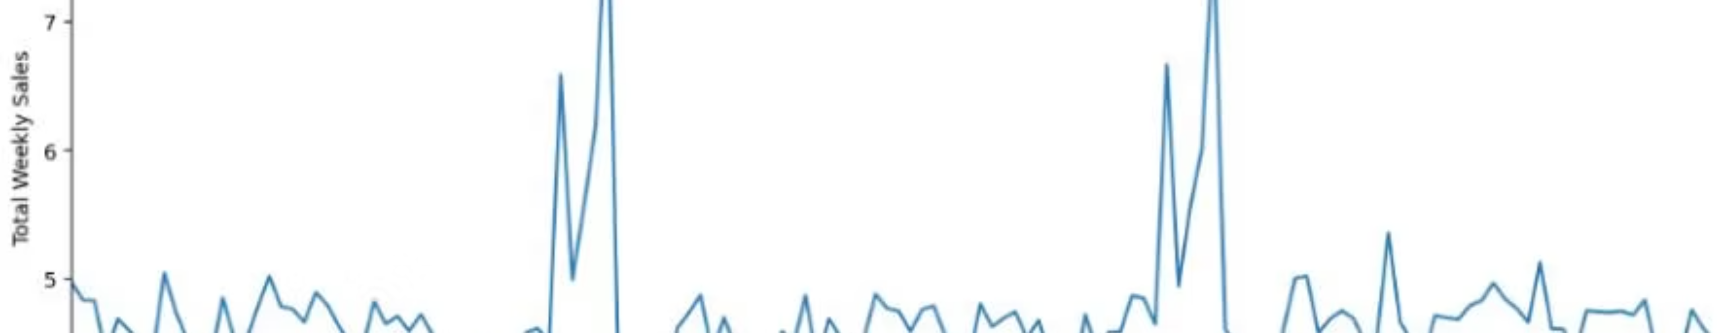

Sales Performance Over Time
Weekly sales are generally stable, but show clear, temporary spikes around major holidays like Thanksgiving and Christmas.
The sales increase is temporary, driven by holiday demand, not long-term growth.

Slide 5
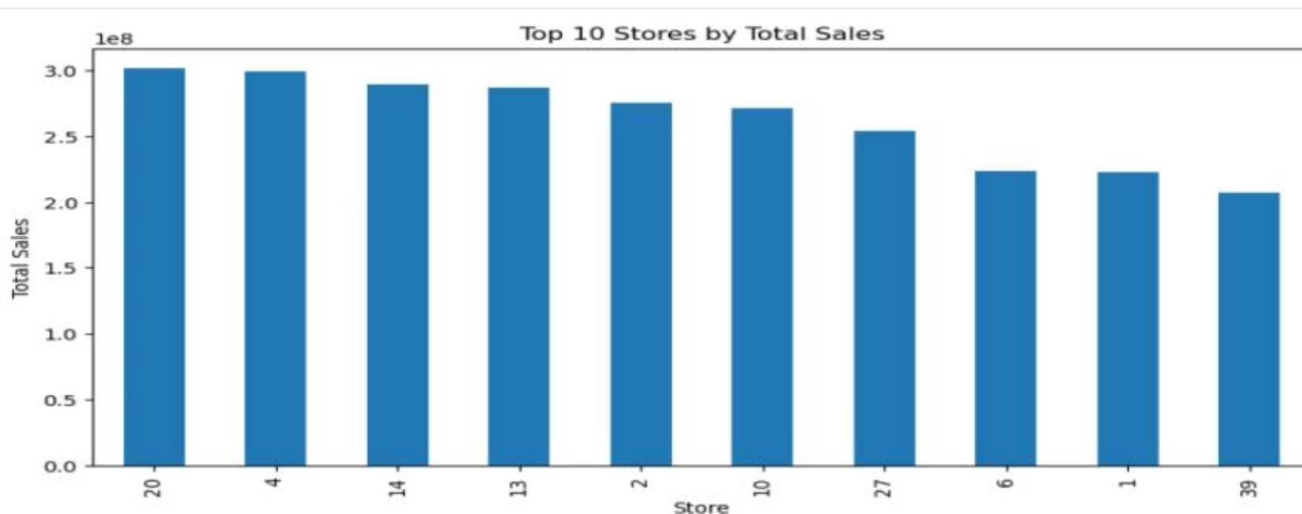
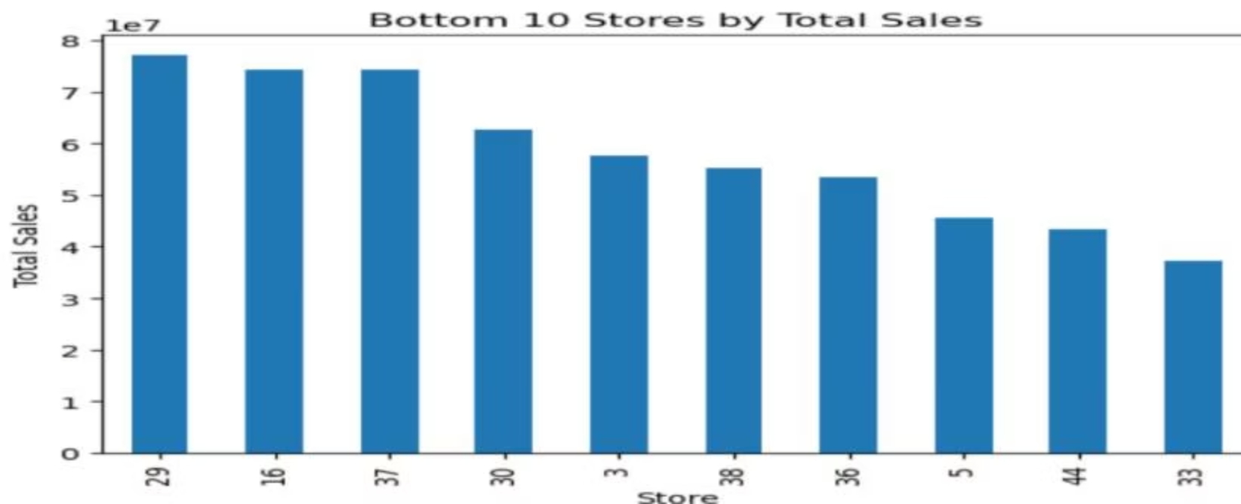
Store Performance: Pareto Principle in Action
Sales performance varies significantly, with a small number of stores generating the majority of total revenue.
Top-Performing Stores
Lowest-Performing Stores
Store 20: Highest Revenue Contributor
Store 33: Lowest Overall Sales
Store 4
Store 44
Store 14
Store 5
Store 13
Store 36

Slide 6
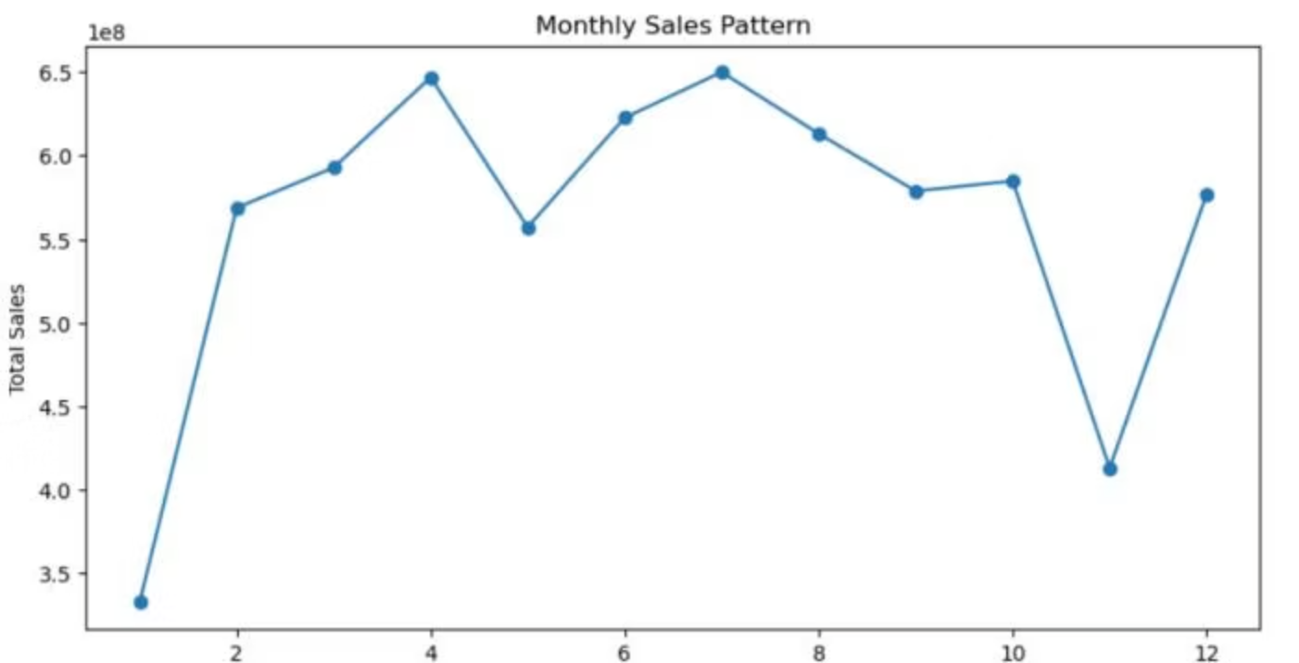
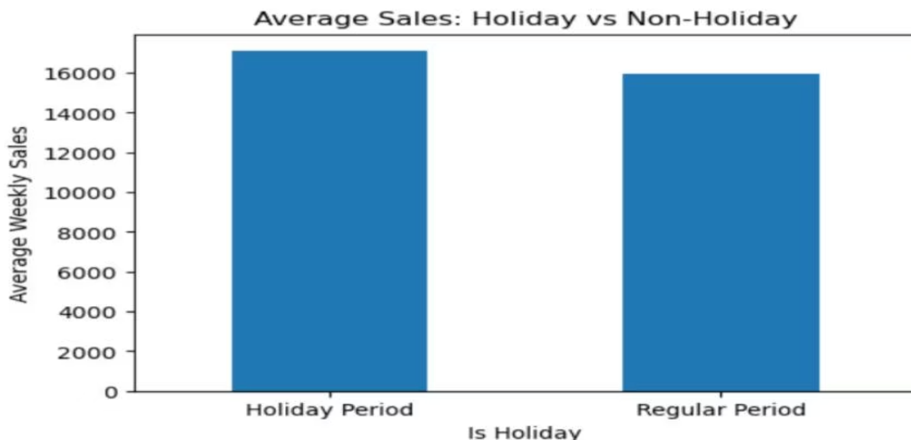
Impact of Holidays and Seasonality
Sales are highly seasonal, but the impact of general "holiday weeks" is minimal compared to major events.
Seasonal Cycle
Holiday Effect
Sales are weaker at the beginning of the year, strengthen mid-year, dip in November, and recover in December. This pattern is crucial for planning.
Average weekly sales during holiday weeks (~17,093) are only slightly higher than regular weeks (~15,950). Only major holidays cause noticeable spikes.

Slide 7
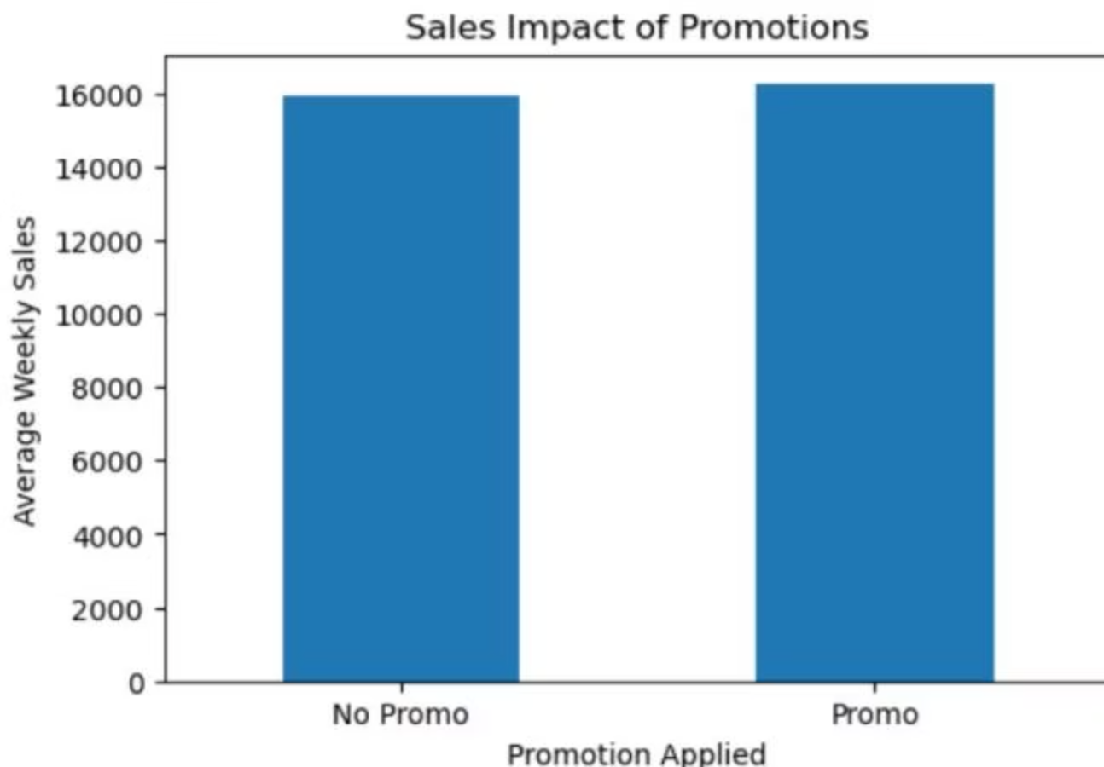
Promotions and Economic Factors
Neither promotions nor external economic indicators show a strong correlation with overall weekly sales.
Promotional Lift is Modest
Weak Economic Correlation
Promotions increase average weekly sales by about 310 (from ~15,919 to ~16,229). This is a modest lift when averaged across all products and weeks.
The correlation between weekly sales and factors like Fuel Price, CPI, Unemployment, and Temperature is very weak. Sales are driven more by internal factors.
Fuel Price
9.2e-05
CPI
-0.021
Unemployment
-0.026
Temperature
-0.0023

Slide 8
Identifying Unstable and Risky Stores
Store-level sales variability highlights two types of risk: extreme volatility and consistent underperformance.
Most Unstable
Performance Risk
Stores 10, 35, 23, and 13 show large, unpredictable spikes, making demand forecasting extremely difficult.
Stores 33, 5, 9, and 44 show consistently low and stagnant sales, posing a long-term performance risk.

Slide 9
Chapter 2
Actionable Recommendations
Optimize Inventory
1
Increase inventory levels before major holidays and use seasonality patterns for better demand planning.
Target Low Performers
2
Focus improvement strategies and resources on consistently low-performing stores (e.g., Store 33, 44).
Monitor Unstable Stores
3
Closely monitor stores with extreme spikes (e.g., Store 10, 35) to reduce inventory risks and improve forecasting accuracy.
Refine Promotions
4
Evaluate promotion effectiveness at the store or department level, as the overall impact is limited.

Slide 10




Final Summary: Key Drivers of Sales
Walmart's weekly sales are primarily driven by internal factors, not external economic shifts.
Seasonality
Major Holidays
Clear annual sales cycle.
Event-specific demand spikes.
Promotions
Store-Specific Factors
Limited overall impact.
High variability and Pareto distribution.

